Slide 1

Virtual TryOn
SRM INSTITUTE OF SCIENCE AND TECHNOLOGY
COLLEGE OF ENGINEERING AND TECHNOLOGY
DEPARTMENT OF NETWORKING AND COMMUNICATIONS
18CSP107L / 18CSP108L- MINOR PROJECT / INTERNSHIP
Student 1 Reg No:RA1911003010823
Student 2 Reg No:RA19110003010413
Batch ID:B056
Guide name :Dr.R.Thenmozhi

Slide 2
Table of contents
Introduction
Objectives
Methodology
Comparison of Existing methods with merits and demerits
Literature Survey
Architecture diagram / Block diagram of the modules
Screenshots
References

Slide 3
Introduction
Nowadays, people are purchasing most of their items online a are spending more on it especially in fashion items since browsing different styles and categories of clothes is easy with just a few mouse dicks. Despite the convenience that online shopping provides, customers tend to concern about how a particular fashion item image on the website would fit with themselves.
An online Shopping Website assisted with AR and Virtual-tryon model using Lip_Jppnet and Tensorflows Posenet to bridge the Gap between shopping at a Physical location and shopping online.

Slide 4
Objectives
There is an urgent demand to provide a quick and simple solution for virtual try-on. Instead of using 3D information such as depth of the image, we believe simply rely on the regular 2D photo is the most convenient way to satisfy this need. With the recent progress in virtual try-on technologies, people can have a better online shopping experience by accurately envisioning themselves wearing the dothes from online categories

Slide 5
Methodology
There are two stages of the development for our project. First, to prepare input image for the network by openpose and selection parsing for model image, then we use a two-stage solution to deal with the virtual try-on problem. First, it learns a transformation for transforming the clothes into fitting the body shape of the target person via a new Geometric Matching Module (GMM). Second, to mitigate edge artifacts of warped clothes and make the results more realistic, Then it applies a Try-On Module that learns a combination mask to integrate the warped clothes and the rendered image to ensure smoothness..

Slide 6
Literature Survey
Journal/Conference Name | Brief/Abstract
C-VTON (2022) Context-Driven Image-Based Virtual Try-On Network | They proposed cpvton a approach to image-based virtual try-on capable of synthesizing highquality try-on results across a wide range of input-image characteristics. The model was evaluated in extensive experiments on the VITON They faced issues in rendering unrealistic and soft garment edges, incorrectly synthesized clothing types and improperly rendered neck areas.

Slide 7
Literature Survey
Journal/Conference Name | Brief/Abstract
Dress Code: High-Resolution Multi-Category Virtual Try-On(2022) | In this paper, they presented Dress Code: a new dataset for image-based virtual try-on. Dress Code, while being more than 3× larger than the most common dataset for virtual try-on, is the first publicly available dataset for this task featuring clothes of multiple macro-categories and high-resolution images.

Slide 8
Literature Survey
Journal/Conference Name | Brief/Abstract
Dressing in Order:Recurrent Person Image Generation for Pose Transfer, Virtual Try-on and Outfit Editing (2021) | This paper is the first that introduced a flexible person generation pipeline trained on pose transfer and inpainting but capable of diverse garment layering and editing tasks for which there is no direct supervision. some limitaions on their model is while processing rarely seen poses are not always rendered correctly, unusual garment shapes are not preserved, some ghosting artifacts are present, and holes in garments are not always filled in properly

Slide 9
Literature Survey
Journal/Conference Name | Brief/Abstract
Parser-Free Virtual Try-on via Distilling Appearance Flows (2021) | This paper proposed a model by which they generated a rendered image of wrapping the garment around the model without human parsing . Theirapproach treats the fake images produced by the parserbased network as input of the parser-free student network, which is supervised by the original real image

Slide 10
Literature Survey
Journal/Conference Name | Brief/Abstract
Disentangled Cycle Consistency for Highly-realistic Virtual Try-On (2021) | Their model typically consist of a oneway reconstruction scheme or a vanilla cycle consistency . The oneway reconstruction scheme hinders existing methods from sufficient training, while the vanilla cycle consistency methods lack the texture preservation ability. In this paper, they proposed DCTON to disentangle virtual try-on as clotheswarping, skin synthesis, and image composition. These modules are integrated within one framework for end-toend cycle consistent training.

Slide 11
Literature Survey
Journal/Conference Name | Brief/Abstract
ZFlow: Gated Appearance Flow-based Virtual Try-on with 3D Priors (2021) | this model proposed by Ayush Chopra*†2, Rishabh Jain *‡3, Mayur Hemani1 , and Balaji Krishnamurthy1 is an end-to-end try-on framework,which utilizes a combination of gated aggregation of hierarchical flow estimates (Gated Appearance Flow) and densegeometric priors (DGAR and IUV Priors) to reduce undesirable output artefacts.

Slide 12
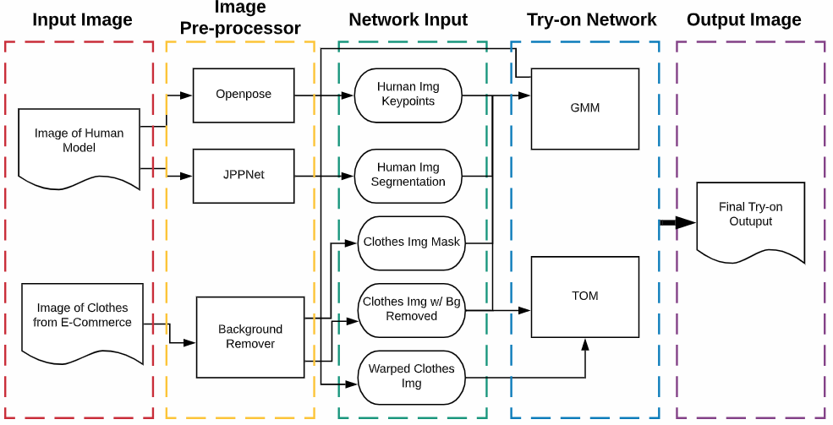
Architecture diagram

Slide 13
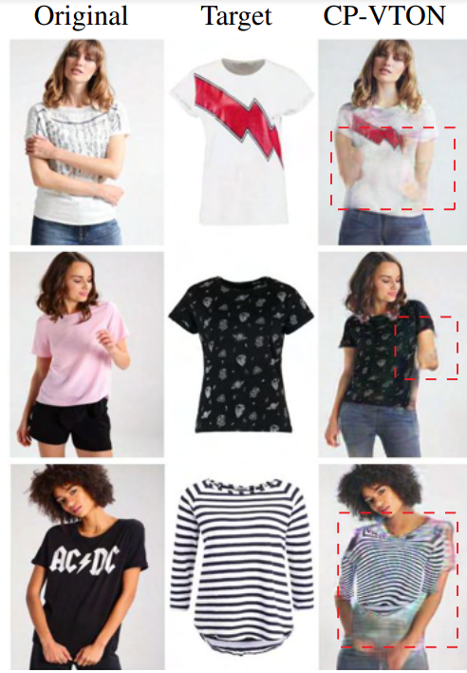
Comparison of Existing methods with merits and demerits
In our model we plan to fix the issues of previously existing models like cpvton where the output render fails in areas like :

Slide 14
Comparison of Existing methods with merits and demerits
When the model goes from wearing half sleeved or sleeveless garment to a full sleeved garment and vice-versa
When the model poses in a untradional manner
When the user try to layer garments on top of each other
When the garment has complex pattern
When the model goes from having the garment tucked-in to tucked-out and vice-versa
etc.

Slide 15
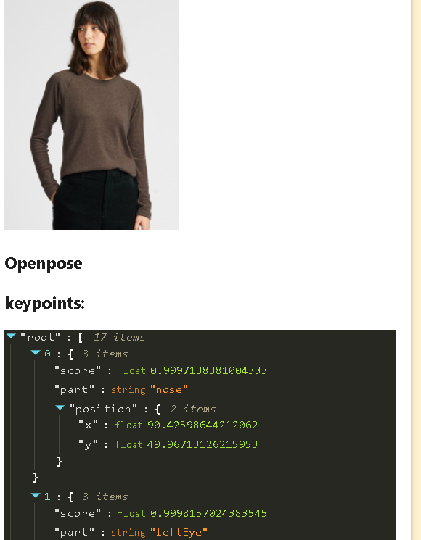
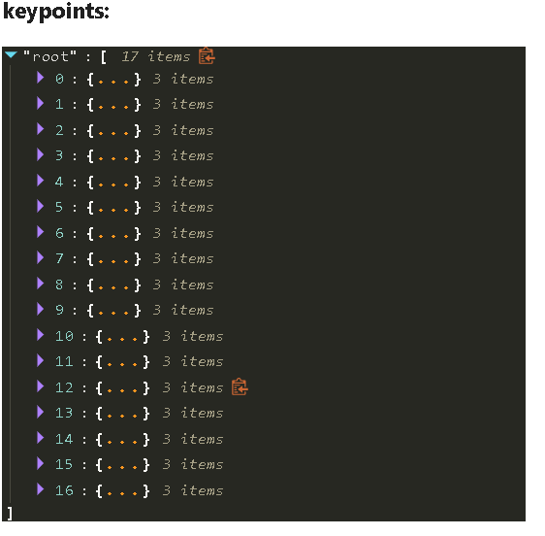
Screenshots

Slide 16
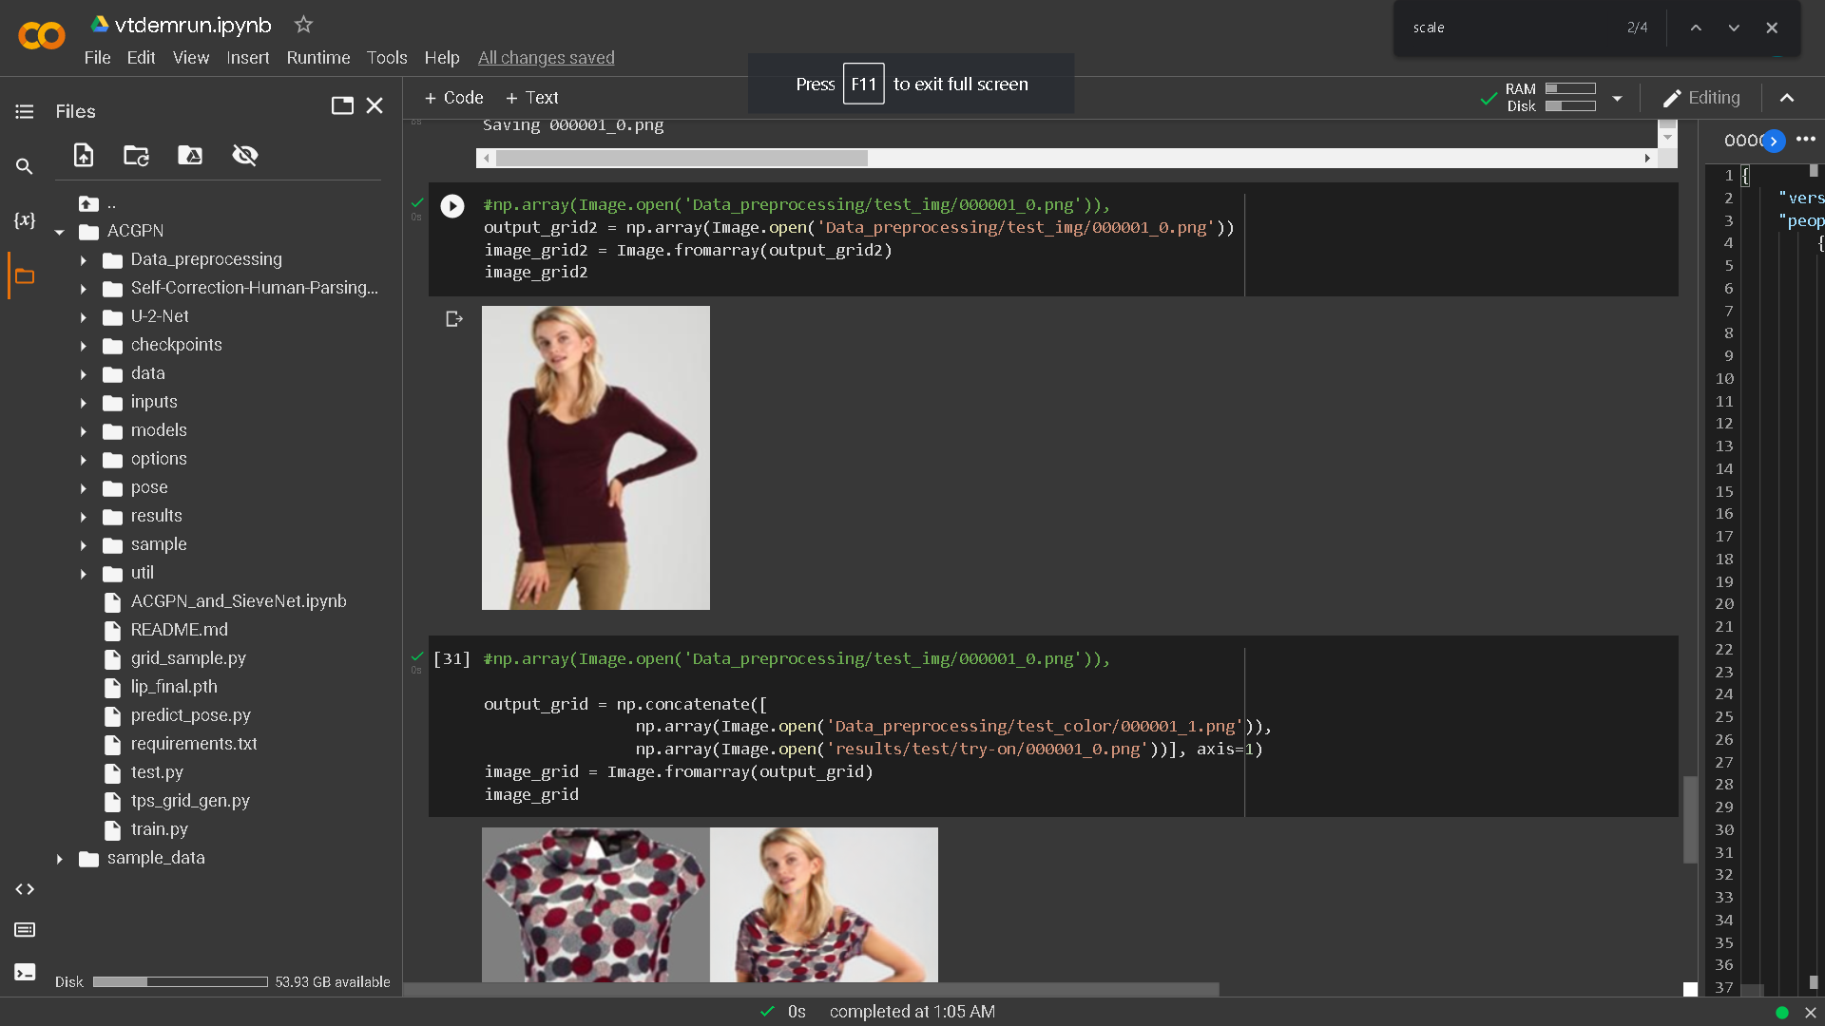
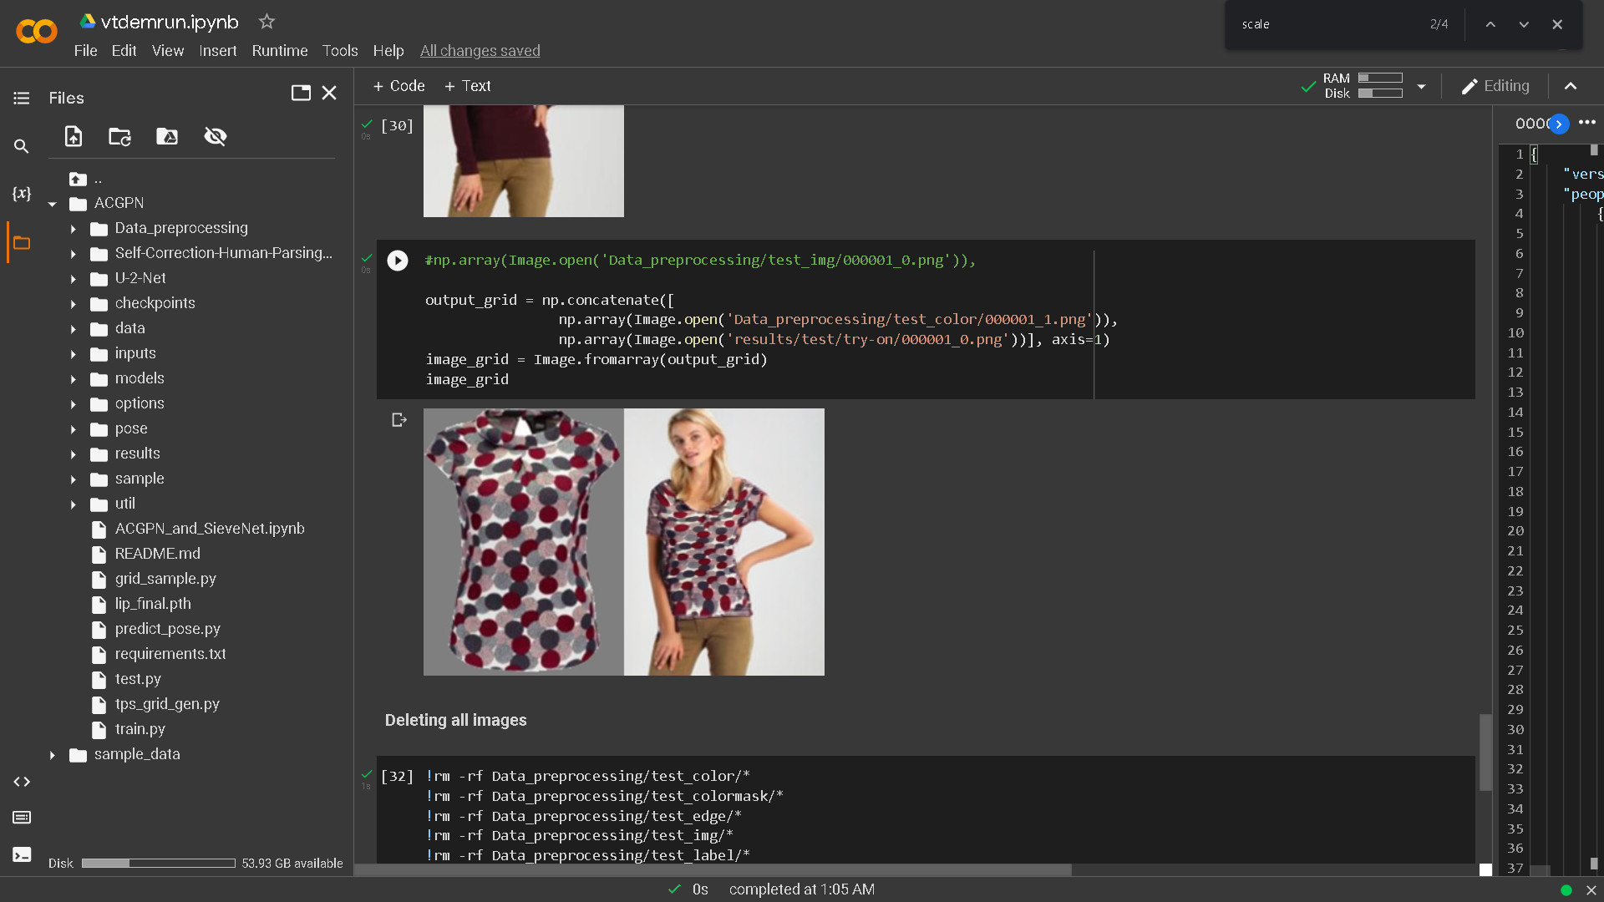
Screenshots

Slide 17
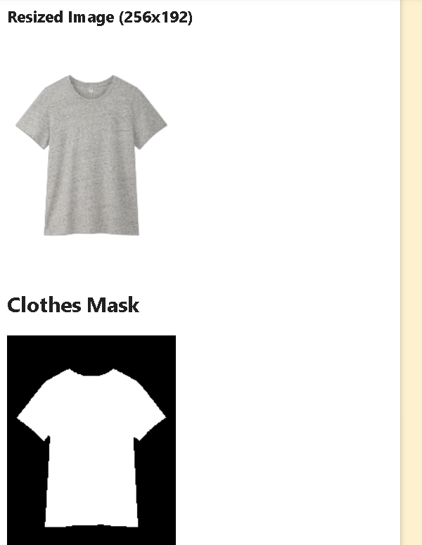

Screenshots

Slide 18
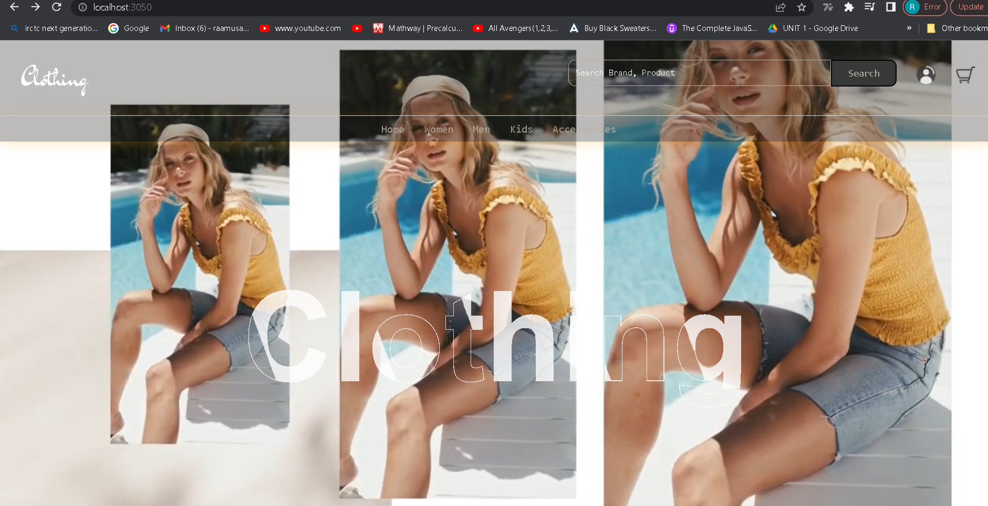
Screenshots

Slide 19

Screenshots

Slide 20

Screenshots

Slide 21
References
Cao, Zhe, Gines Hidalgo, Tomas Simon, Shih-En Wei, and Yaser Sheikh. 2018. "OpenPose: Realtime Multi-Person 2D Pose Estimation Using Part Affinity Fields." In ArXiv Preprint arXiv:1812.08008.
Kenan E. Ak, Ashraf A. Kassim, Joo Hwee Lim, and Jo Yew Tham. Learning attribute representations with localization for flexible fashion search. In The IEEE Conference on Computer Vision and Pattern Recognition (CVPR), June 2018
Seunghwan Choi, Sunghyun Park, Minsoo Lee, and JaegulChoo. Viton-hd: High-resolution virtual try-on viamisalignment-aware normalization. In Proceedings of theIEEE/CVF Conference on Computer Vision and PatternRecognition (CVPR), pages 14131–14140, June 2021.
Matiur Rahman Minar, Thai Thanh Tuan, Heejune Ahn, Paul Rosin, and Yu-Kun Lai. CP-VTON+: Clothing Shape andTexture Preserving Image-based Virtual Try-on. In Computer Vision and Pattern Recognition Workshops (CVPR-W),page 11, 2020.
Igor Santesteban, Miguel A Otaduy, and Dan Casas.Learning-based Animation of Clothing for Virtual Try-on.Computer Graphics Forum, 38(2):355–366, 2019.
Rıza Alp Guler, Natalia Neverova, and Iasonas Kokkinos. Densepose: Dense human pose estimation in the wild. InCVPR, 2018.
Haoye Dong, Xiaodan Liang, Xiaohui Shen, Bochao Wang,Hanjiang Lai, Jia Zhu, Zhiting Hu, and Jian Yin. Towardsmulti-pose guided virtual try-on network. In ICCV, 2019.
Benjamin Fele1,2 Ajda Lampe1,2 Peter Peer2 Vitomir Struc ˇ 1C-VTON: Context-Driven Image-Based Virtual Try-On Network
Parser-Free Virtual Try-on via Distilling Appearance FlowsYuying Ge1 Yibing Song2∗ Ruimao Zhang3 Chongjian Ge1 Wei Liu4 Ping Luo1
Dressing in Order: Recurrent Person Image Generation for Pose Transfer,Aiyu Cui Daniel McKee Svetlana Lazebnik
Dual-Branch Collaborative Transformer for Virtual Try-OnEmanuele Fenocchi1, Davide Morelli1, Marcella Cornia1, Lorenzo Baraldi1Fabio Cesari2, Rita Cucchiara1
Full-Range Virtual Try-On with Recurrent Tri-Level TransformHan Yang1,2 Xinrui Yu3 Ziwei Liu4

Slide 22
Thanks

